Slide 1
BC Randonneurs CC Ridership

Slide 2
Notes:
Includes brevets, fleches, traces and permanents, in BC and outside BC. More events in recent years. Permanents started in BC in 2008.

Slide 3
Total KM by Age Group for All Years
Average age for men is 53 and for women is 47
Notes:
Includes brevets, fleches, traces and permanents, in BC and outside BC. More events in recent years. Permanents started in BC in 2008.

Slide 4
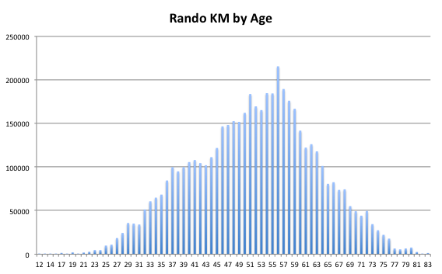
Target Rider is 56 Years Old

Slide 5
Those 64 Year Olds….

Slide 6
Super Seniors

Slide 7
Male Dominated, Except 58 Year Olds

Slide 8
Riders Who Do Not Return (red) By Ride Year
Blue are riders with > 1 ride year, Red are riders with 1 ride year
Notes:
Of 1806 new riders in all years, 816 have returned and 990 only rode one season, average 45% return rate.

Slide 9
Returning Riders By Ride Year
Notes:
Rocky Years 96, 97, 98, 2000, 02, 04, 08, 12, 16
PBP Years 79, 83, 87, 91, 95, 99, 2003, 2007, 2011, 2015

Slide 10
Returning Riders Spanning 25 Years+
Notes:
Could be two rides in two years…. 25 years apart.

